Slide 1
Final Presentation
By Kameron Gilham

Slide 2
The Problem
The goal of this project is to find out which type/genre of YouTube videos end up trending.
Sort the videos more thoroughly using text mining techniques.
Not all the tags are accurate and/or are to narrow of a range

Slide 3
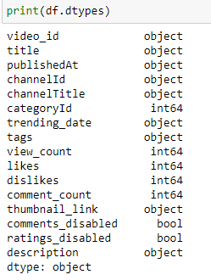

Introduction to data
Attributes
On the left are all the attributes
The main ones that I used:
Titles
Tags
View Count
Likes
Dislikes
Comment Count
Description
Size
106,991 rows
16 columns

Slide 4
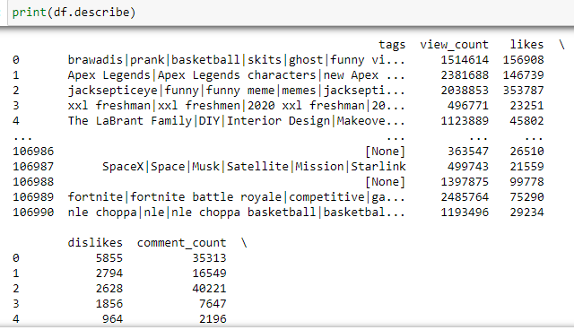
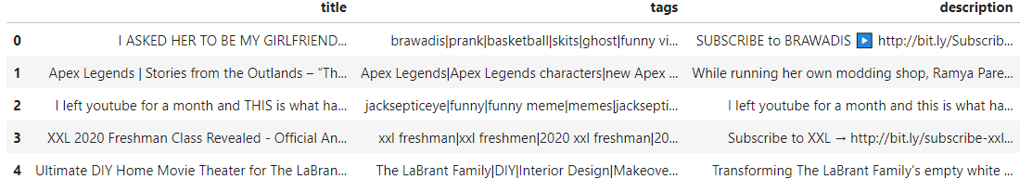
Introduction to data cont.
Statistical Summary
Tags, view count, likes, dislikes, and comment count
Tag Variety
Basketball
Apex Legends
Sports

Slide 5
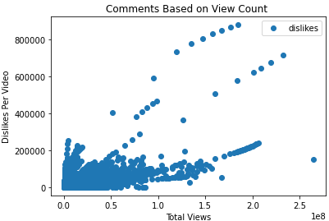
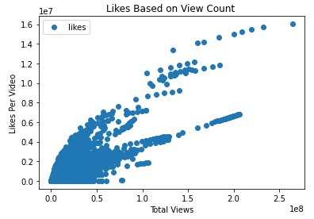
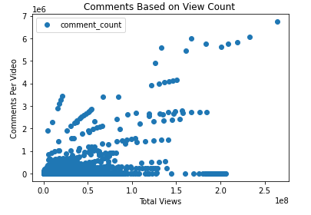
Visualization
The graphs are just a little visualization on the likes, dislikes, and comments based on the number of views
Trending aims to surface videos that a wide range of viewers would find interesting. Some trends are predictable, like a new song from a popular artist or a new movie trailer. Others are surprising, like a viral video.
Depends on how quickly a video generated views

Slide 6
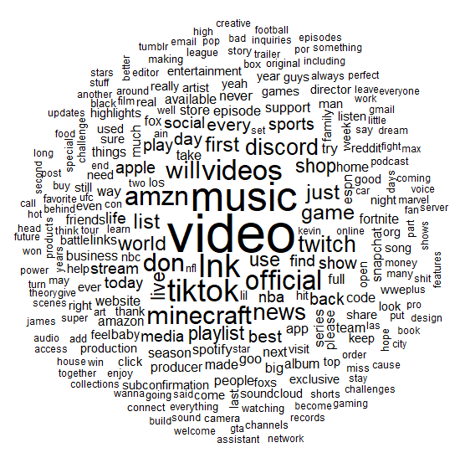
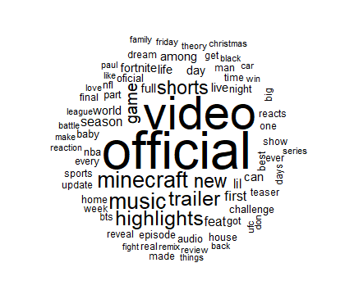
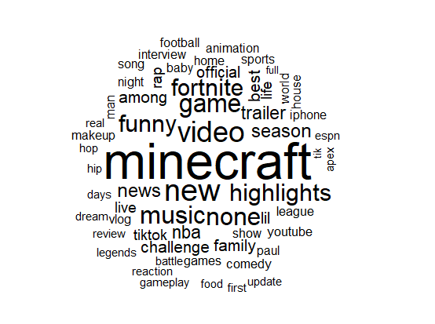
WordCloud
Description
Titles
Tags
This took the longest. A lot of slang words and misspellings that I did my best to filter out.
I threw this one in because I thought it wouldn’t hurt to have and could help with my end goal.
This was the most important one. The tags sort the videos and describe the video.

Slide 7
Challenges
Word cloud took longer than expected. Struggled to get it running and also having to filter a lot of useless words.
Clustering was a struggle. I was able to use pieces of it for the word count.
Time management was another challenge with the project. With a busy schedule and trying to keep up with my deadlines. I would sometimes miss a deadline I set.
Last challenge was underestimating some of the difficulty with the code.

Slide 8
Success
I got the wordcloud
Ability to salvage techniques and use them for others
Feel like I challenged myself
Generated somewhat of an idea of what genres end up on the trending page of YOutube
https://www.kaggle.com/rsrishav/youtube-trending-video-dataset/code

